Slide 1
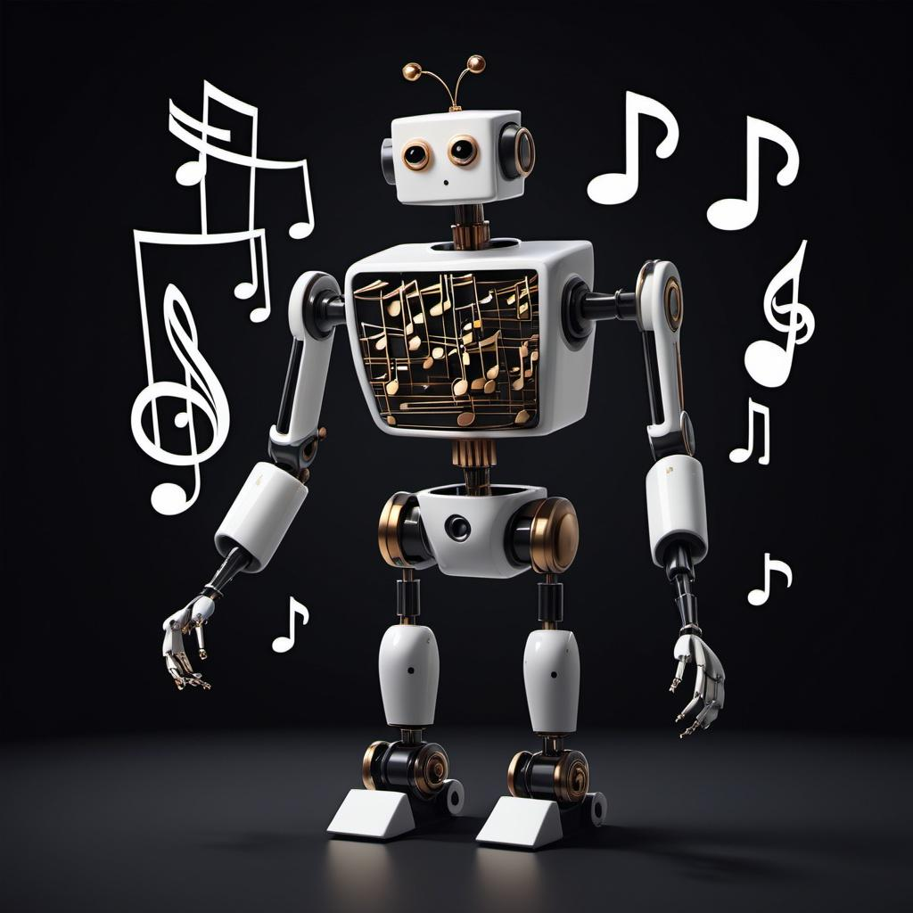
TENSOR TUNE!!
ITAI 2376: Deep Learning
Dr. Awodogan
A Song to Learn about Tensors

Slide 2
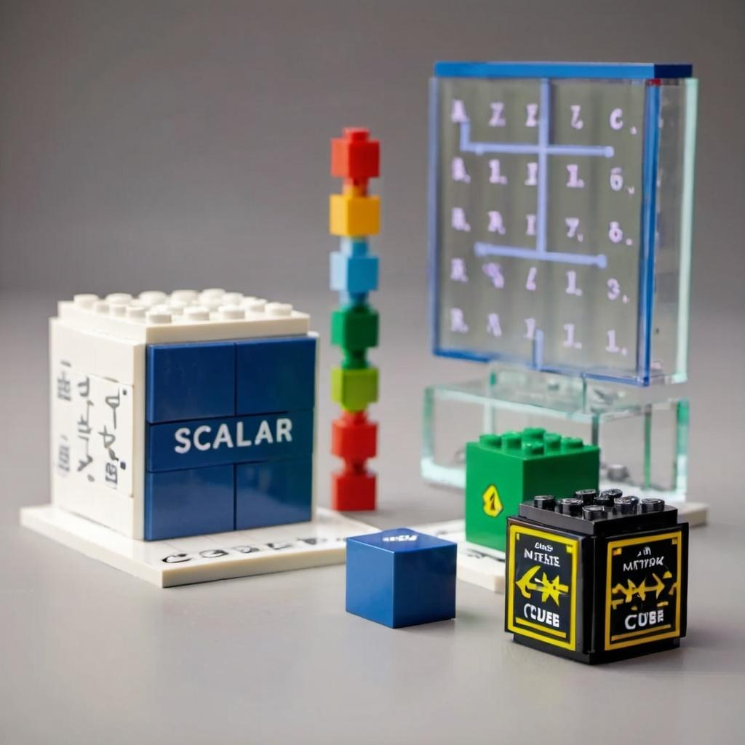
WHAT IS A TENSOR?
A TENSOR is like a container for numbers.
It can hold ONE number, a list, a table, or even bigger shapes!
For example:
[ [1, 2],
[3, 4] ]
Essentially, a TENSOR is a multi-dimensional array, and the shapes can vary based on the data it holds.

Slide 3

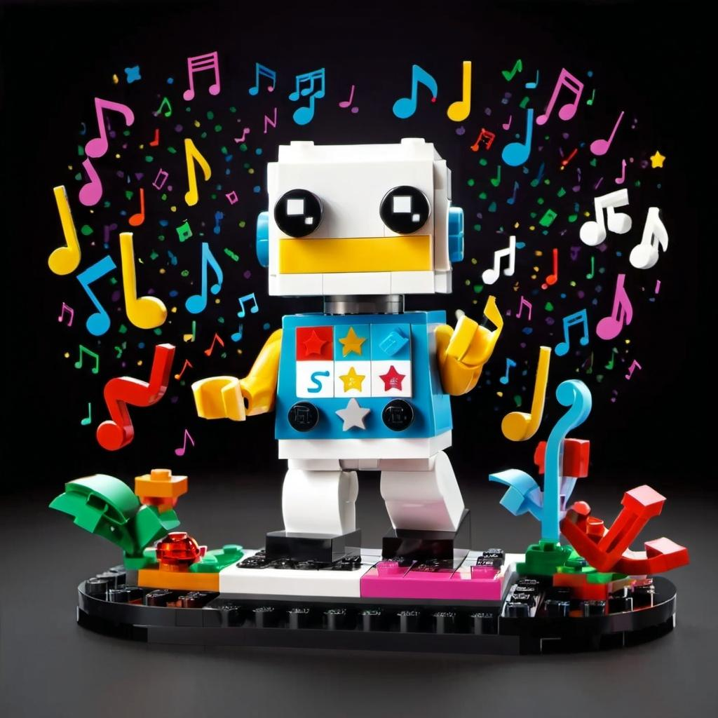
In order to understand Tensors Let’s sing a song!!
Tensors, tensors, what are you?
Shapes of numbers more than two!
Scalars, Vectors, Matrices too
Higher Ranks will join the crew!
Tensors, tensors what are you?
Now I’ll tell you what they do!

Slide 4
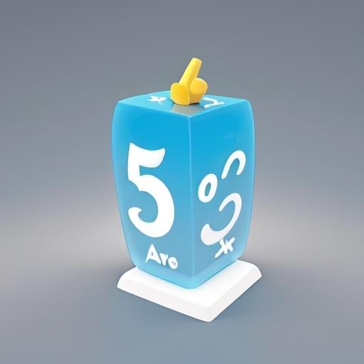
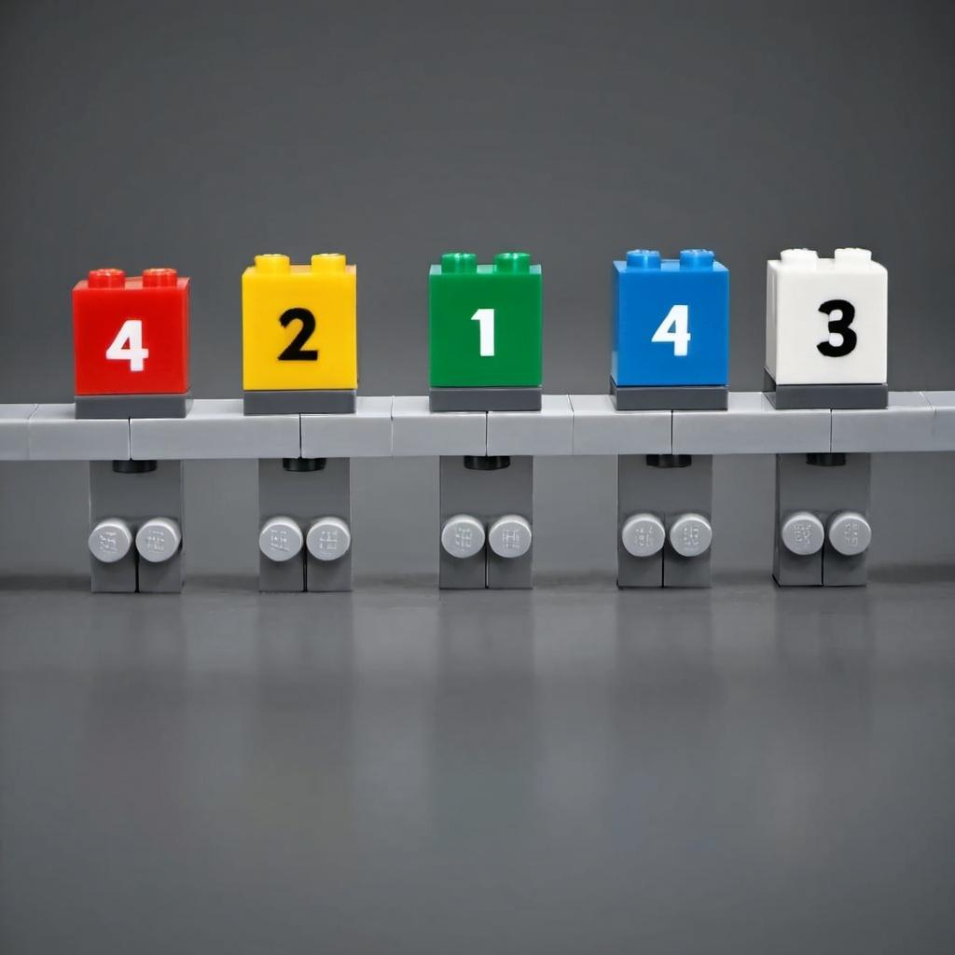
ONE NUMBER IS A SCALAR
One is just a simple spot,
Like a number, that’s a dot!
Two’s a line - up, down,side,
That’s a Vector, watch it glide!

Slide 5
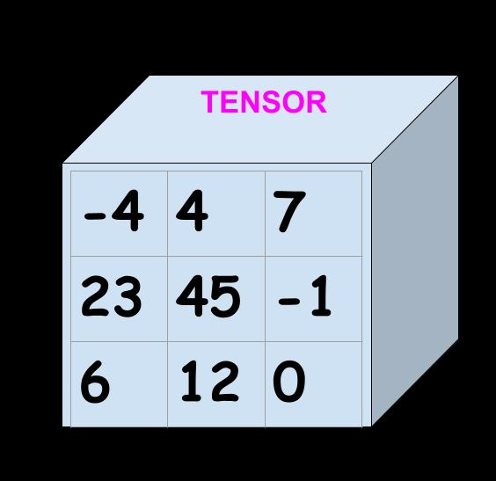
Matrices and Beyond!
Three’s a grid, rows, and stacks,
A Matrix front to back!
Four and more? That’s Tensorland!
Shapes and data hand in hand.
MATRIX
5
6
7
15
18
21
50
60
-70

Slide 6
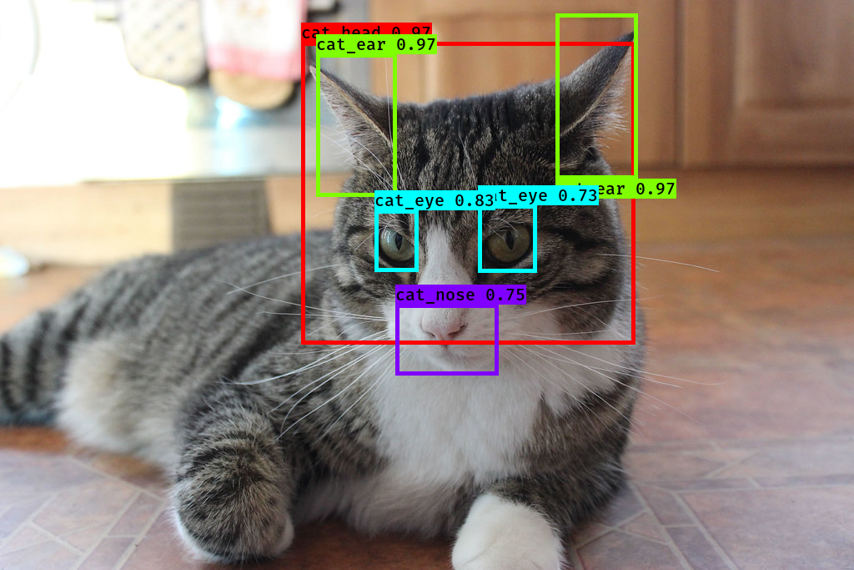
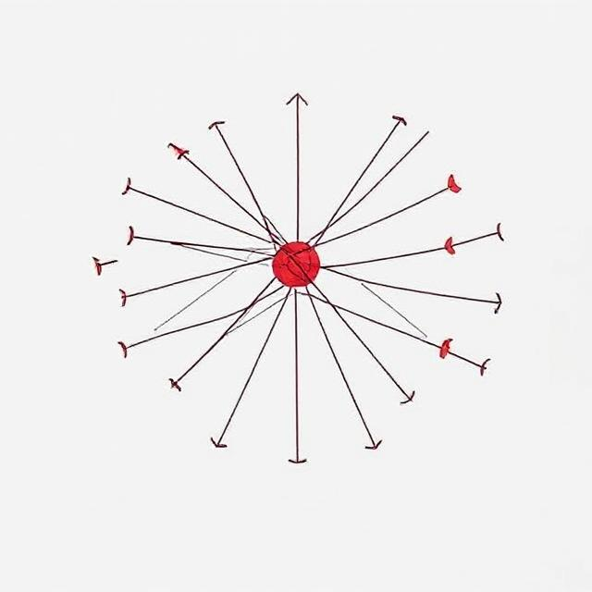

AI LOVES TENSORS!
Neural nets? They love these guys!
Tensors crunch and analyze
From your voice to cool AI,
Tensors help computers try!

Slide 7

MAGIC OF TENSORS
So next time you hear AI say,
“How can I help you today?”
Know that tensors work inside,
Making magic far and wide!

Slide 8

THANK YOU FOR SINGING ALONG!!
Team Tensor Titans: Annette Bazan, Elijah Ghaya, Elizabeth Martinez, and Yammine Gabriel Yammine
Remember Tensors make AI smart! The more you know!

Slide 9
REFERENCES:
Introduction to Tensors | TensorFlow Core
(392) 3Blue1Brown - YouTube
You searched for TENSORS | Towards Data Science
Tensor Definition | DeepAI

